Slide 1
Cohort State-Transition Models
Decision Modeling for Public Health
November 2020

Slide 2
Cohort State-Transition Modeling Overview
Notes:
Part 1 = Showing code 3 state model
Part 2 = Exercise build Sick-Sicker model
Part 3 = Show answers of Sick-Sicker

Slide 3
Cohort State-Transition Models
Model that describes how a cohort is distributed across health states over time
e.g., healthy, sick, stable, progressed, dead
Allow transitions between states with some probability
Transitions are modeled in discrete time steps (e.g. weekly, monthly, yearly)

Slide 4
Cohort Model Assumptions
Health states are mutually exclusive, collectively exhaustive
Within a given health state, population is homogeneous
Markovian assumption: transition probabilities depends only on current health state (“memoryless”)

Slide 5
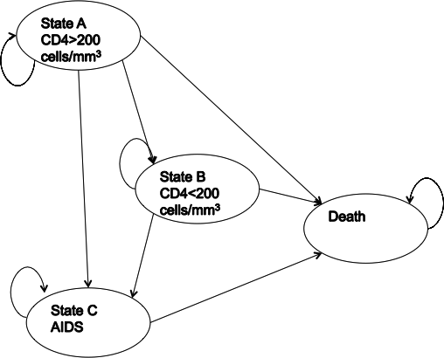
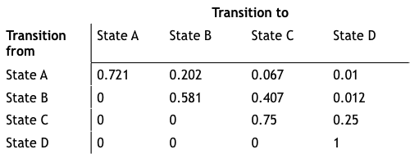
Simple State-Transition Model of HIV Progression
Transition probability matrix
State-transition diagram
Drummond, Michael F. Methods for the economic evaluation of health care programmes. Oxford university press, 2005.

Slide 6
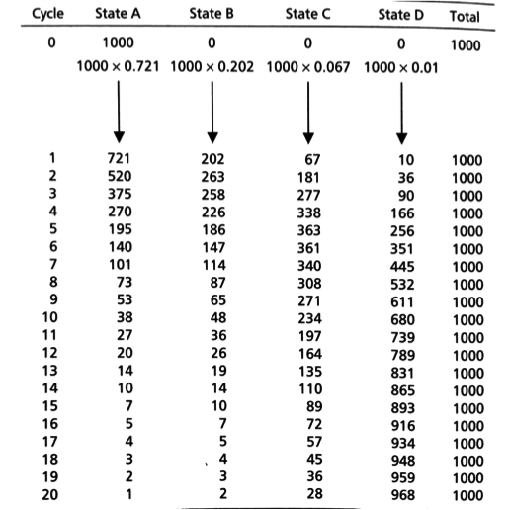
Cohort
"Trace”
Number or proportion of individuals at each time step

Slide 7
Simple 3-State Example
Notes:
Part 1 = Showing code 3 state model
Part 2 = Exercise build Sick-Sicker model
Part 3 = Show answers of Sick-Sicker

Slide 8
Three-State Model
p_HH
p_HS
p_SS
Healthy (H)
Sick (S)
p_HD
p_SD
Dead (D)
To:
 | Healthy | Sick | Dead
Healthy | p_HH | p_HS | p_HD
Sick | 0 | p_SS | p_SD
Dead | 0 | 0 | p_DD
p_DD
From:

Slide 9
Three-State Model
0.05
0.93
p_HS
0.90
1 - 0.02 - 0.05
1 - 0.10
p_HH
p_SS
Healthy (H)
Sick (S)
p_HD
p_SD
0.02
0.10
Dead (D)
To:
 | Healthy | Sick | Dead
Healthy | p_HH | p_HS | p_HD
Sick | 0 | p_SS | p_SD
Dead | 0 | 0 | p_DD
p_DD
1.0
From:

Slide 10
Three-State Model
0.05
0.93
p_HS
0.90
1 - 0.02 - 0.05
1 - 0.10
p_HH
p_SS
Healthy (H)
Sick (S)
p_HD
p_SD
0.02
0.10
Dead (D)
To:
 | Healthy | Sick | Dead
Healthy | 0.93 | 0.05 | 0.02
Sick | 0 | 0.90 | 0.10
Dead | 0 | 0 | 1.0
p_DD
1.0
From:

Slide 11

Simulate the Cohort over Time
Initial cohort distribution:
Cohort distribution at next time step is calculated through matrix multiplication
x₀ = [1.0 0.0 0.0]
(everyone starts healthy)
Transition Probability Matrix
$$P$$
x_{t+1}
=
x_{t}

Slide 12
Simulate the Cohort over Time
Initial cohort distribution:
Cohort distribution at next time step is calculated through matrix multiplication
x₀ = [1.0 0.0 0.0]
(everyone starts healthy)
x₁
x₀
0.93
0.05
0.02
x_{t+1}
=
1.0
x_{t}
0
0.90
0.10
0.0
0.0
0
0
1.0

Slide 13
Simulate the Cohort over Time
Initial cohort distribution:
Cohort distribution at next time step is calculated through matrix multiplication
x₀ = [1.0 0.0 0.0]
(everyone starts healthy)
x₁
x₀
0.93
0.05
0.02
0.93
=
1.0
0.0
0.0
0
0.90
0.10
0
0
1.0
(0.93)(1.0) + (0.0)(0.0) + (0.0)(0.0)
(p_{Healthy,Healthy} )*Pr(healthy) + (p_{Sick,Healthy} )*Pr(sick) + (p_{Dead,Healthy} )*Pr(dead)

Slide 14
Simulate the Cohort over Time
Initial cohort distribution:
Cohort distribution at next time step is calculated through matrix multiplication
x₀ = [1.0 0.0 0.0]
(everyone starts healthy)
x₁
x₀
0.93
0.05
0.02
x_{t+1}
=
1.0
x_{t}
0
0.90
0.10
0.93
0.05
0.0
0.0
0
0
1.0
(0.05)(1.0) + (0.90)(0.0) + (0.0)(0.0)

Slide 15
Simulate the Cohort over Time
Initial cohort distribution:
Cohort distribution at next time step is calculated through matrix multiplication
x₀ = [1.0 0.0 0.0]
(everyone starts healthy)
x₁
x₀
0.93
0.05
0.02
x_{t+1}
=
1.0
x_{t}
0
0.90
0.10
0.93
0.05
0.02
0.0
0.0
0
0
1.0

Slide 16
Simulate the Cohort over Time
Initial cohort distribution:
Cohort distribution at next time step is calculated through matrix multiplication
x₀ = [1.0 0.0 0.0]
(everyone starts healthy)
x₂
x₁
0.93
0.05
0.02
0.87
x_{t+1}
=
0.93
0.05
0.02
0
0.90
0.10
0
0
1.0
(0.93)(0.93) + (0.0)(0.05) + (0.0)(0.02)

Slide 17
Simulate the Cohort over Time
Initial cohort distribution:
Cohort distribution at next time step is calculated through matrix multiplication
x₀ = [1.0 0.0 0.0]
(everyone starts healthy)
x₂
x₁
0.93
0.05
0.02
0.87
x_{t+1}
=
0.93
0.05
0.02
0
0.90
0.10
0.09
0
0
1.0
(0.05)(0.93) + (0.90)(0.05) + (0.0)(0.02)

Slide 18
Simulate the Cohort over Time
Initial cohort distribution:
Cohort distribution at next time step is calculated through matrix multiplication
x₀ = [1.0 0.0 0.0]
(everyone starts healthy)
x₂
x₁
0.93
0.05
0.02
0.87
x_{t+1}
0.04
=
0.93
0.05
0.02
0
0.90
0.10
0.09
0
0
1.0
(0.02)(0.93) + (0.10)(0.05) + (1.0)(0.02)

Slide 19
Simulate the Cohort over Time
Cohort distribution over time:
Cohort trace:
x₃ = [0.80 0.13 0.07]
x₀ = [1.0 0.0 0.0]
x₁ = [0.93 0.05 0.02]
x₂ = [0.87 0.09 0.04]
x₄ = [0.75 0.15 0.10]

Slide 20
Calculating Model Outcomes
Notes:
Part 1 = Showing code 3 state model
Part 2 = Exercise build Sick-Sicker model
Part 3 = Show answers of Sick-Sicker

Slide 21
Expected outcomes
Expected remaining life-years, quality-adjusted life-years (QALYs), costs
Generally calculated over lifetime
Multiply cohort distribution by state-specific values to calculate expected value at each cycle
Sum expected values over time
discount if desired

Slide 22
Remaining Life-Expectancy
State-specific values: 1 if alive, 0 if dead
State values:
1.0
1.0
0.0
Time | Healthy | Sick | Dead | E[LYs]
0 | 1.0 | 0.0 | 0.0 | --
1 | 0.93 | 0.05 | 0.02 | 0.98
2 | 0.87 | 0.09 | 0.04 | 0.96
3 | 0.80 | 0.13 | 0.07 | 0.93
 | … | … | …
Total life years: 21.0 years

Slide 23
Remaining QALE
Remaining quality-adjusted life-expectancy (QALE)
State-specific values: utility of that state
State values:
0.8
0.5
0.0
Time | Healthy | Sick | Dead | E[QALYs]
0 | 1.0 | 0.0 | 0.0 | --
1 | 0.93 | 0.05 | 0.02 | 0.77
2 | 0.87 | 0.09 | 0.04 | 0.74
3 | 0.80 | 0.13 | 0.07 | 0.71
 | … | … | …
Total QALYs: 14.7 QALYs

Slide 24
Remaining costs
Remaining lifetime health care costs
State-specific values: cost of spending one cycle in that health state
State values:
$400
$1,000
$0
Time | Healthy | Sick | Dead | E[costs]
0 | 1.0 | 0.0 | 0.0 | --
1 | 0.93 | 0.05 | 0.02 | $422
2 | 0.87 | 0.09 | 0.04 | $438
3 | 0.80 | 0.13 | 0.07 | $450
 | … | … | …
Total health care costs: $12,531

Slide 25

Discounting
In cost-effectiveness analysis, costs and QALYs are discounted at some rate, $r$
At each cycle $t$, multiply expected outcome by the discount factor: $\frac{1}{{\left(1+r\right)}^{t}}$
State values:
0.8
0.5
0.0
Time | Healthy | Sick | Dead | E[QALYs]
0 | 1.0 | 0.0 | 0.0 | --
1 | 0.93 | 0.05 | 0.02 | 0.77
2 | 0.87 | 0.09 | 0.04 | 0.74
3 | 0.80 | 0.13 | 0.07 | 0.71
 | … | … | …
Sum
* 1/(1+r)
* 1/(1+r)²
* 1/(1+r)³
Total QALYs: 14.7 QALYs
Total discounted (3% per year) QALYs: 10.2 QALYs

Slide 26
Time-Varying State-Transition Models
Notes:
Part 1 = Showing code 3 state model
Part 2 = Exercise build Sick-Sicker model
Part 3 = Show answers of Sick-Sicker

Slide 27
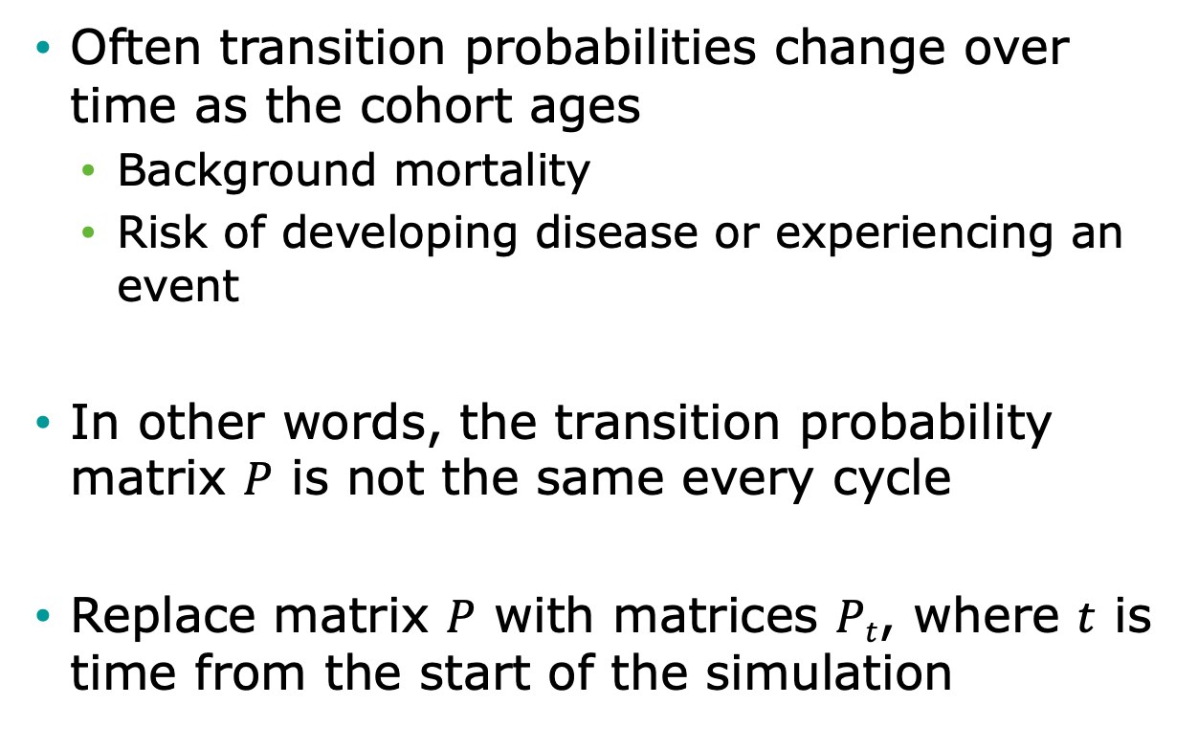
Time-Varying Probabilities
Often transition probabilities change over time as the cohort ages
Background mortality
Risk of developing disease or experiencing an event
In other words, the transition probability matrix $P$ is not the same every cycle
Replace matrix $P$ with matrices $Pt$, where $t$ is time from the start of the simulation

Slide 28
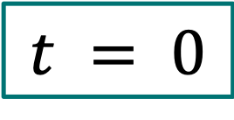
Three-State Model
0.05
0.93
p_HS
0.90
1 - 0.02 - 0.05
1 - 0.10
p_HH
p_SS
Healthy (H)
Sick (S)
$$t = 0$$
p_HD
p_SD
0.02
0.10
Dead (D)
To:
 | Healthy | Sick | Dead
Healthy | 0.93 | 0.05 | 0.02
Sick | 0 | 0.90 | 0.10
Dead | 0 | 0 | 1.0
p_DD
1.0
From:

Slide 29
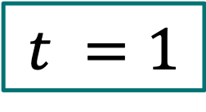
Three-State Model
0.05
0.92
p_HS
0.88
1 - 0.02 - 0.05
1 - 0.10
p_HH
p_SS
Healthy (H)
Sick (S)
$$t =1$$
p_HD
p_SD
0.03
0.12
Dead (D)
To:
 | Healthy | Sick | Dead
Healthy | 0.92 | 0.05 | 0.03
Sick | 0 | 0.88 | 0.12
Dead | 0 | 0 | 1.0
p_DD
1.0
From:

Slide 30

Three-State Model
0.05
0.91
p_HS
0.86
1 - 0.02 - 0.05
1 - 0.10
p_HH
p_SS
Healthy (H)
Sick (S)
$$t =2$$
p_HD
p_SD
0.04
0.14
Dead (D)
To:
 | Healthy | Sick | Dead
Healthy | 0.91 | 0.05 | 0.04
Sick | 0 | 0.86 | 0.14
Dead | 0 | 0 | 1.0
p_DD
1.0
From:

Slide 31

Simulating Cohort with Time-Varying Probabilities
Cohort distribution at next time step is still calculated through matrix multiplication, but matrix changes over time
Transition Probability Matrix
$$P_{t}$$
x_{t+1}
=
x_{t}

Slide 32




Transition Probability Array
Stack cycle-specific transition probability matrices together to form a transition probability array
$$t =3$$
. . .
$$t =2$$
0.90
0.05
0.05
0.91
0.05
0.04
$$t =1$$
0
0.84
0.16
0
0.86
0.14
0.92
0.05
0
0
1.0
$$t =0$$
0.03
0
0
0
1.0
0.93
0.05
0.88
0.12
0.02
0
0
0
1.0
Third dimension is time
0.90
0.10
0
0
1.0

Slide 33
Conditional Transitions
Always need to ensure that rows of the transition probability matrix sum to 1
When modeling aging cohorts over a lifetime, oldest ages have high probabilities of mortality
The sum of age-specific mortality with other possible events, if defined as independent, can exceed 1
Defining transitions as conditional is one approach to avoiding this problem

Slide 34
Conditional Transitions
Problem: Sum of transition probabilities can exceed 1 over time
0.55
0.01
0.0
Uh oh!
Healthy (H)
Sick (S)
0.44
0.45
0.46
Dead (D)

Slide 35
Conditional Transitions
Solution: Condition other events on survival
0.55
0.01
0.0
Uh oh!
Healthy (H)
Sick (S)
0.44
0.45
0.46
Dead (D)

Slide 36
Conditional Transitions
Solution: Condition other events on survival
1-0.55
0.55
1-0.46
Healthy (H)
survive
Sick (S)
0.46
die
Dead (D)

Slide 37



Conditional Transitions
Solution: Condition other events on survival
($1−p_{t}$)*0.55
($1−p_{t}$)*(1-0.55)
Healthy (H)
Sick (S)
$$p_{t}$$
Dead (D)

Slide 38
History Dependence
Notes:
Part 1 = Showing code 3 state model
Part 2 = Exercise build Sick-Sicker model
Part 3 = Show answers of Sick-Sicker

Slide 39
History Dependence
“Memoryless” property of state transition models is a BIG assumption
Transition probabilities only depend on the current state and not on past states
Many transition probabilities depend on model history, not just time since model start
Risk of myocardial infarction (MI) greater for persons with prior MI
Effectiveness of a drug used as first-line therapy may be better than if used as second-line therapy

Slide 40
When history matters, create more states…
Healthy – Sick - Dead:
Once recovered, the risk of getting sick again or dying increases
Healthy (H)
Sick (S)
Dead (D)
Healthy (H)
Sick (S1)
Recovered (R)
Dead (D)
Healthy – Sick – Recovered - Dead

Slide 41

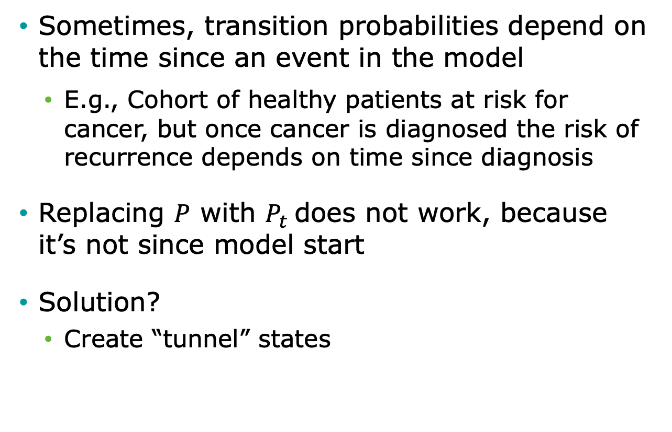
Tunnel states
Sometimes, transition probabilities depend on the time since an event in the model
E.g., Cohort of healthy patients at risk for cancer, but once cancer is diagnosed the risk of recurrence depends on time since diagnosis
Replacing $P$ with $P_{t}$does not work, because it’s not since model start
Solution?
Create “tunnel” states

Slide 42
State Time
f(model time)
f(state time)
Healthy
Cancer
Recur
Dead
Tunnel state

Slide 43
Tunnel States
p_Recur₁
Cancer 1
p_Recur₂
Cancer 2
p_Recur₃
Cancer 3
Recur
p_Recur₄
Cancer 4
p_Recur_{n}
Cancer n
Transitions to Dead also allowed.

Slide 44
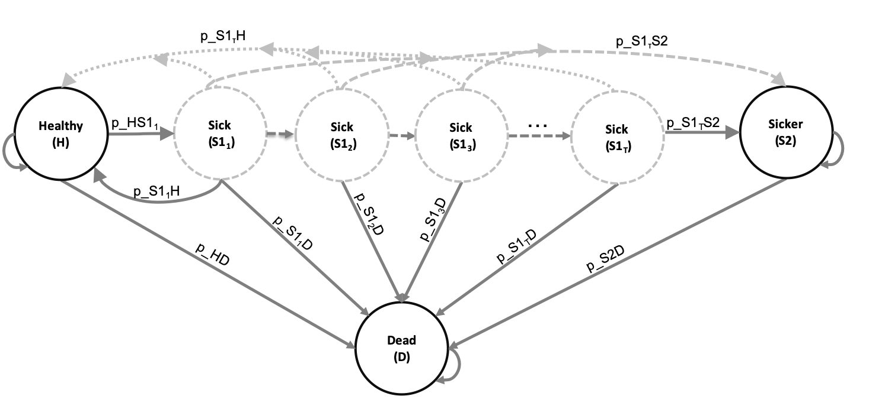
Time-dependent probabilities
Expand the states of the 3D array by the number of cycles considered in the time-dependency variable(s)
For the Sick-Sicker Markov model:

Slide 45
END?
Notes:
Part 1 = Showing code 3 state model
Part 2 = Exercise build Sick-Sicker model
Part 3 = Show answers of Sick-Sicker

Slide 46
END?
Notes:
Part 1 = Showing code 3 state model
Part 2 = Exercise build Sick-Sicker model
Part 3 = Show answers of Sick-Sicker

Slide 47
END?
Notes:
Part 1 = Showing code 3 state model
Part 2 = Exercise build Sick-Sicker model
Part 3 = Show answers of Sick-Sicker

Slide 48
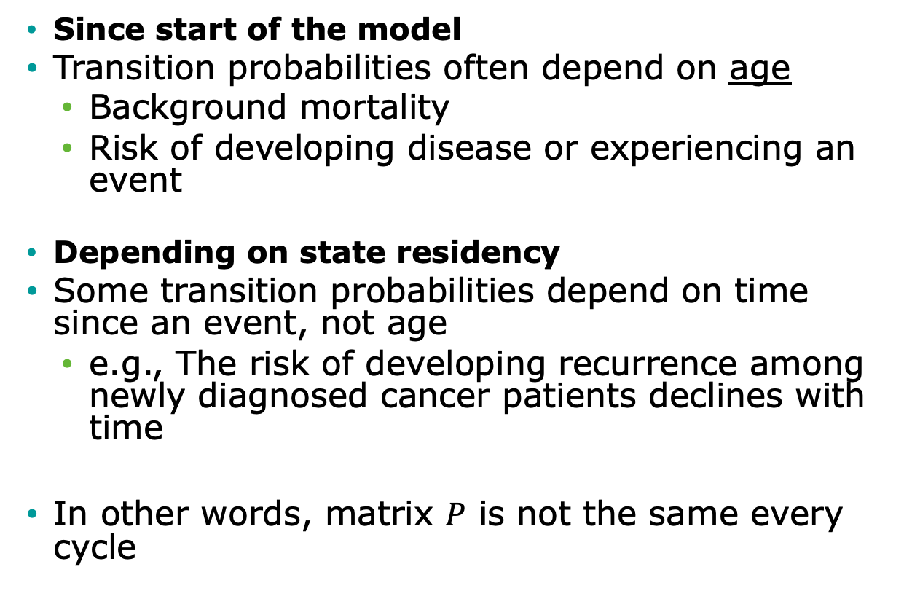
Time-dependency
Since start of the model
Transition probabilities often depend on age
Background mortality
Risk of developing disease or experiencing an event
Depending on state residency
Some transition probabilities depend on time since an event, not age
e.g., The risk of developing recurrence among newly diagnosed cancer patients declines with time
In other words, matrix $P$ is not the same every cycle

Slide 49
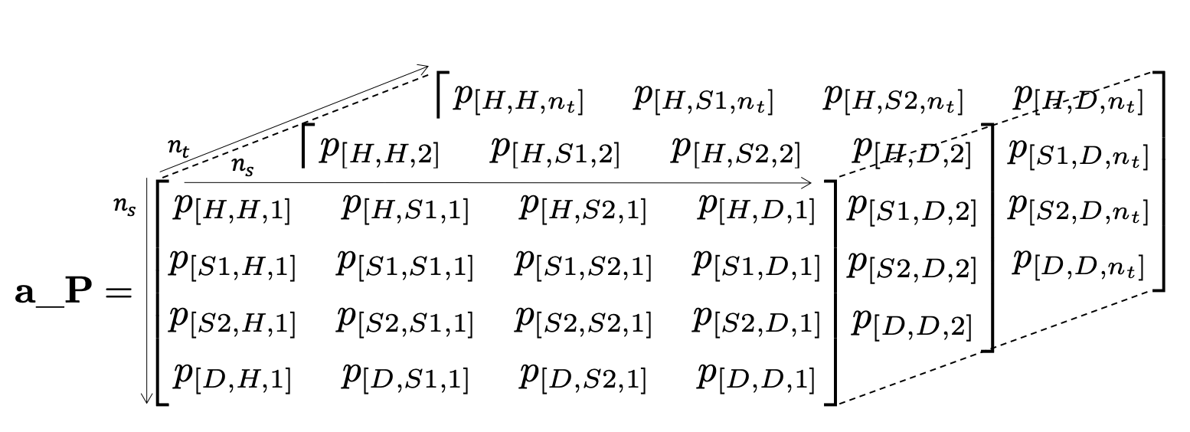
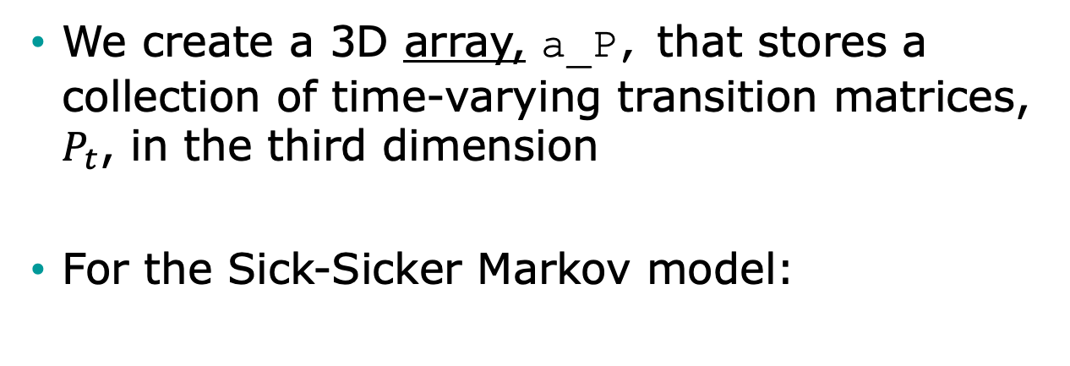
Time-varying probabilities in R
We create a 3D array, a_P, that stores a collection of time-varying transition matrices, $P_{t}$, in the third dimension
For the Sick-Sicker Markov model:

Slide 50
R Session –
3 state example

Slide 51
Conceptualizing the Markov model in R

Slide 52
Simple state transition model in R
p_HS
Healthy (H)
Sick (S)
p_HD
p_SD
Dead (D)
Notes:
Simple Markov to illustrate the use of Markov models
First letter from state and second letter to state

Slide 53
Simple state transition model
Model input:
p_{HS}: transition probability from Healthy to Sick
p_{HD}: transition probability Healthy to Dead
p_{SD}: transition probability Sick to Dead
c_{H}: cost of being in state Healthy
c_{S}: cost of being in state Sick
e_{H}: outcomes associated with state Healthy
e_{S}: outcomes associated with state Sick
No cost or disutility associated with death

Slide 54


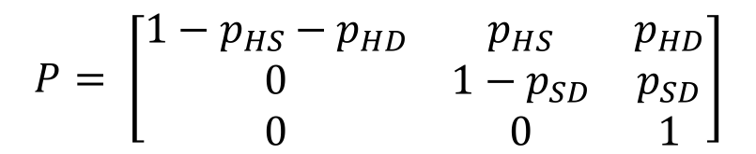
Matrix Implementation of the Markov Model
p_HS
Healthy (H)
Sick (S)
Transition probability matrix
Vector of cycle’s cost/outcomes
H S D
$$P= \left[\begin{matrix}1−p_{HS}−p_{HD} & p_{HS} & p_{HD} \\ 0 & 1−p_{SD} & p_{SD} \\ 0 & 0 & 1\end{matrix}\right]$$
H
S
D
p_HD
p_SD
Dead (D)
$$C= \left[\begin{matrix}c_{H} \\ c_{S} \\ 0\end{matrix}\right]$$
H
S
D
$$E= \left[\begin{matrix}e_{H} \\ e_{S} \\ 0\end{matrix}\right]$$
H
S
D
Notes:
Who is familiar with basic matrix calculations?
-> Inner product

Slide 55
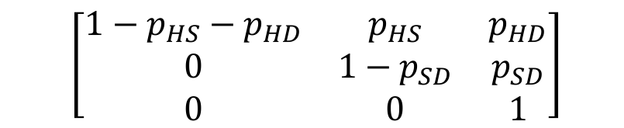

Matrix Implementation of the Markov Model
Create the t x 3 matrix M that will store the proportion of the cohort at each state and cycle:
At t = 0 :
M₀ = [1, 0, 0]
For t < T :
M_{t + 1}=M_{t} P
$$\left[\begin{matrix}1−p_{HS}−p_{HD} & p_{HS} & p_{HD} \\ 0 & 1−p_{SD} & p_{SD} \\ 0 & 0 & 1\end{matrix}\right]$$
$$\left[\begin{matrix}H_{t} & S_{t} & D_{t}\end{matrix}\right]$$

Slide 56
Calculating total costs & effects
E = M e
TE = 1_{T} E
Total effects (TE):
Total costs (TC):
C = M c
TC = 1_{T} C
1_{T} : 1 × T vector of ones
Notes:
M(tx3) e(3x1) = t * 1
(n x m) (m x p) = (n x p)

Slide 57
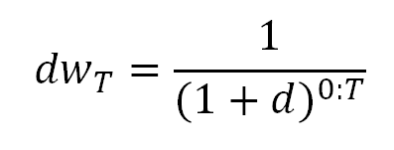
Calculating total costs & effects (discounted)
Total effects (TE):
Total costs (TC):
E = M e
TE = dw_{T} E
C = M c
TC = dw_{T} C
Notes:
M(tx3) e(3x1) = t * 1
(n x m) (m x p) = (n x p)

Slide 58
R Session
Notes:
Part 1 = Showing code 3 state model
Part 2 = Exercise build Sick-Sicker model
Part 3 = Show answers of Sick-Sicker

